Slide 2




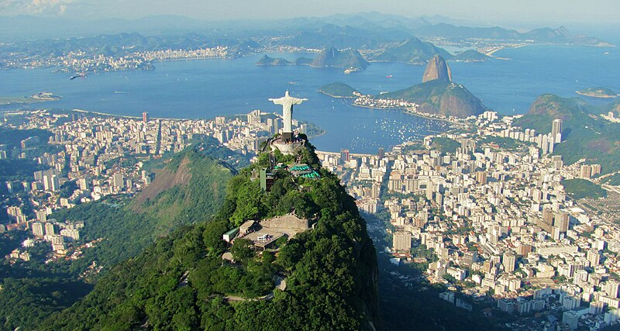
If you could choose any city in the world to visit, which would it be?
Why?

Slide 4
Uncountable and plural nouns
https://www.baamboozle.com/classic/76233

Slide 5
GEP 10 Writing task: Opinion
“Phnom Penh is not a good city to live in. It would be better to live in another city” To what extent do you agree with this statement?
200 words - 30 minutes

Slide 6
Common mistakes
Not stating an opinion
Giving arguments for both views (you should only argue for your viewpoint)
Not supporting your opinion with clear reasons and examples.

Slide 7
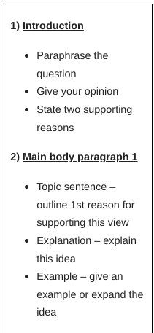
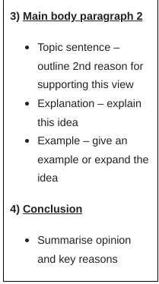

Slide 8
Generate ideas:
What aspects of your lifestyle here in Phnom Penh could you focus on?
You need two points to focus on for two paragraphs.
Remember to provide clear examples to back up your points.

Slide 9
Sentence openers:
Firstly, I disagree/ agree with the statement because [point 1].
For example, in Phnom Penh …
Living in a different city would mean…
Moreover, furthermore…. I disagree/ agree with the statement because…
Whereas in another city you would struggle to find [good opportunities for work], Phnom Penh is the perfect place to live for those seeking jobs.

Slide 10
Model writing

